Slide 1
Unusually Formal Method: a Verilog program verifier
Sophia Zhang

Slide 2
Outline
Introduction
Motivation
Project Goals
Implementation Details
Example
Summary and Next Steps

Slide 3

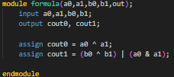
INTRODUCTION: HDLs
Hardware Description Language: language used to describe digital logic circuits
Gate level and higher-level abstractions
For simple logic and complex designs

Slide 4
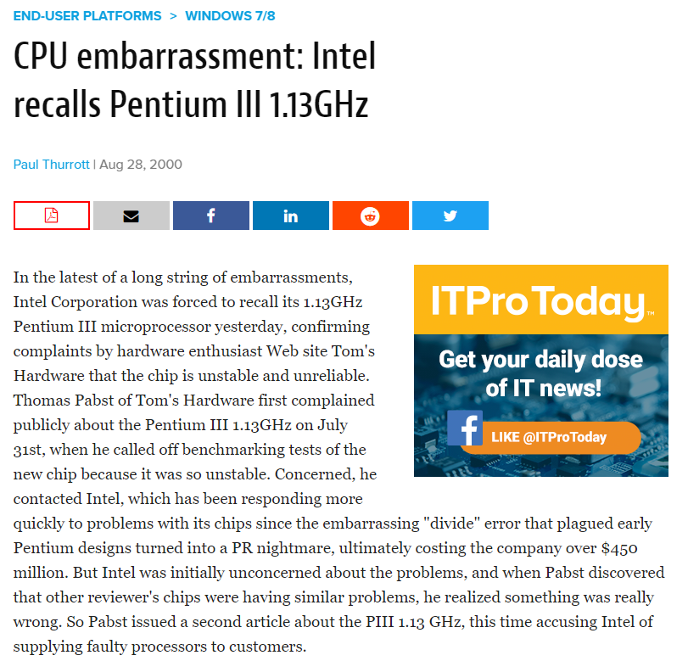
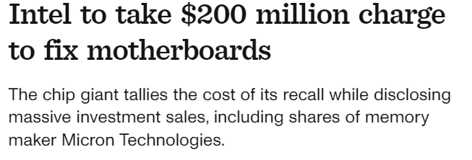

Motivation

Slide 5
Project Goals
A program verifier similar to Dafny
Supports formal verification through annotated post conditions
Supports formal verification of combinational logic

Slide 6
Motivation
Writing unit and coverage tests
Lots of programming effort
May not cover all test cases!
Formal verification
Model checking and program abstraction
Lots of programmer effort + knowledge needed
Lots of resources + time

Slide 7
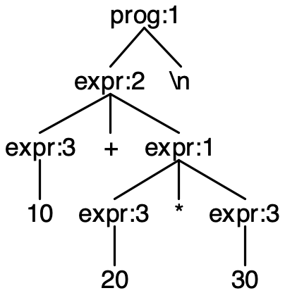




Implementation
mkAdd(10, mkMul(20,30))
…
10+20*30
#ensures(10+20*30==610)
Language Parser
Z3 Boolean Converter
Source code
Syntax Tree
Z3 equivalent

Slide 8
Example: 2-Bit adder

Slide 9
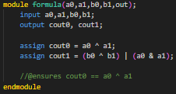
Example: 2-Bit adder

Slide 10
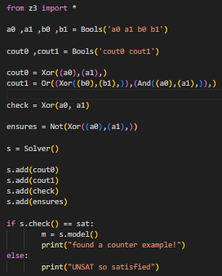
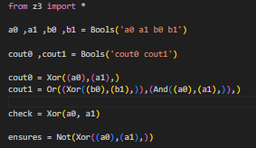
Example: 2-Bit adder

Slide 11

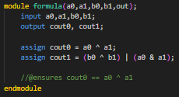
Example: 2-Bit adder

Slide 12
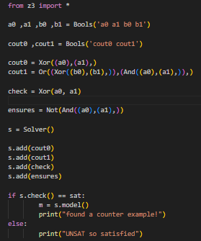

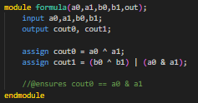
Example: 2-Bit adder

Slide 13
Next Steps
Must Accomplish
Future Directions
Automate the ensures clause in verification
Expand to sequential logic
Expand the abstraction to beyond gate level

Slide 14
SUMMARY
UFM: Unusually formal method a formal program verifier for a subset of the Verilog language

